Slide 1


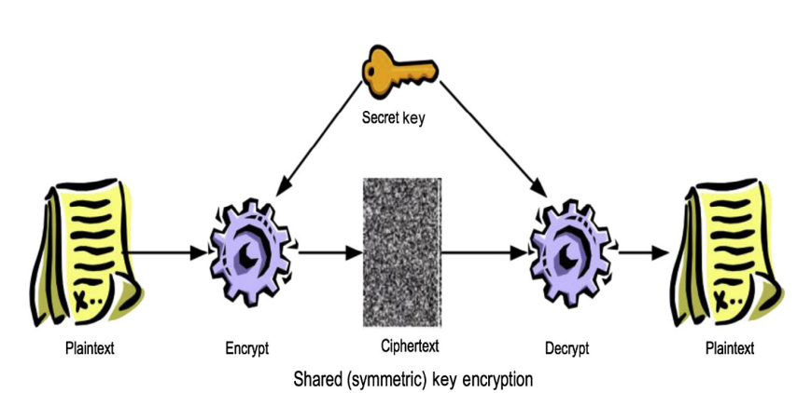
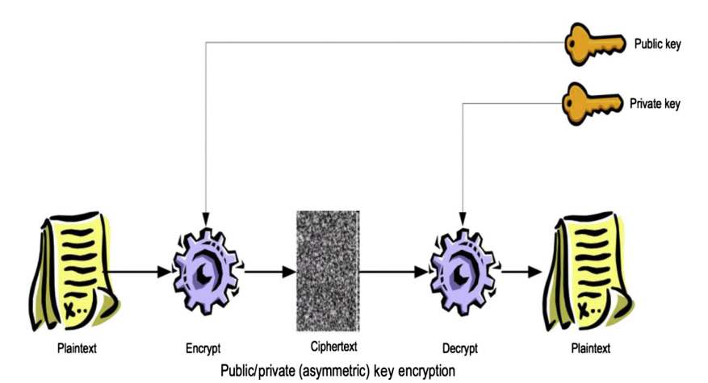


Elderly Care Management System – Yr 4 Project
-By Qadeer Hussain Date: 25/10/2024
What is the project?
It is a secure web application to safeguard and manage patient data in car centres.
Digital documentation to streamline workflow.
Application designed to cater Admin and Carer.
What is Health Level 7 (HL7)?
Is framework for the exchange, integration, sharing and retrieval of health information.
Most used standard globally.
HL7 specifies several standards, guidelines and methodologies for health-related systems.
Existing Systems
A few existing System during I found during research include:
Pass App
Log my Care
Nourish
References
2024) Elderly care vectors & illustrations for free download | Freepik. Available at: https://www.freepik.com/vectors/elderly-care (Accessed: October 2024).
Health Level Seven International, 2024. Introduction to HL7 Standards. [Online]. Available at: https://www.hl7.org/implement/standards/index.cfm?ref=nav [Accessed October 2024].
ScienceDirect, 2017. Embedded security. [Online]. Available at: https://www.sciencedirect.com/topics/computer-science/shared-key-encryption [Accessed October 2024].
Augusto Vega, P. B. A. B., 2017. Rugged Embedded Systems. s.l.:Morgan Kaufmann.
Cryptography images – browse 869,371 stock photos, vectors, and video (2024) Adobe Stock. Available at: https://stock.adobe.com/search?k=cryptography (Accessed: October 2024).
(2024a) Healthcare System Images - free download on Freepik. Available at: https://www.freepik.com/free-photos-vectors/healthcare-system (Accessed: October 2024).
Figure [1]
Technologies
Here are some possible technologies that could be used for example:
Python: https://www.python.org/
Django: https://www.djangoproject.com/
MariaDB: https://mariadb.org/
Cryptography lib: https://pypi.org/project/cryptography/
What is Shared Key and Public Key?
Shared key form of cryptography.
Also known as Symmetric encryption.
Method of encrypting data and decrypting data using one key.
Public key form of cryptography.
Also known a Asymmetric encryption.
Method of encrypting and decrypting data using two keys.
What are the Core features?
This is a list of features that will be included in this project:
Implementing Security
Patient Profile
Care Planer
Medical Dashboard
Roster
Figure [5]
Figure [6]
Figure [3]
Figure [3]

